Slide 1
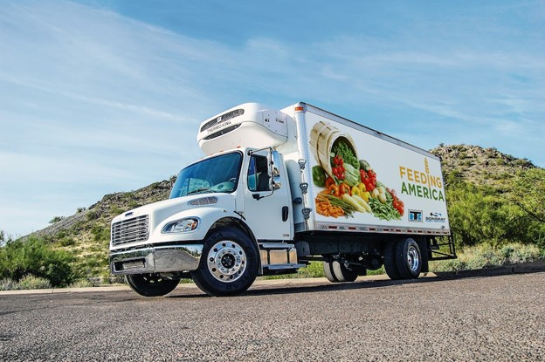
BREAD OF THE MIGHTY
ROUTING PROJECT
Cole Crawford, Ewa Wiercioch
In collaboration with Dr. Kazachkov
Notes:
Meant to be dialogue, but would love input/feedback along the way.. Here’s just some initial thoughts

Slide 2
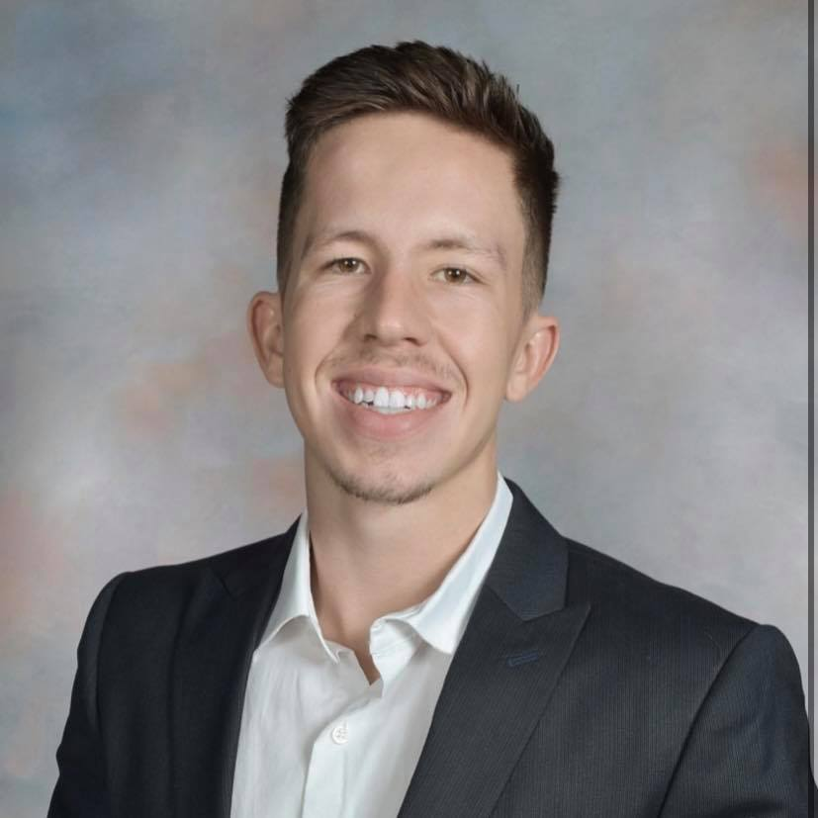
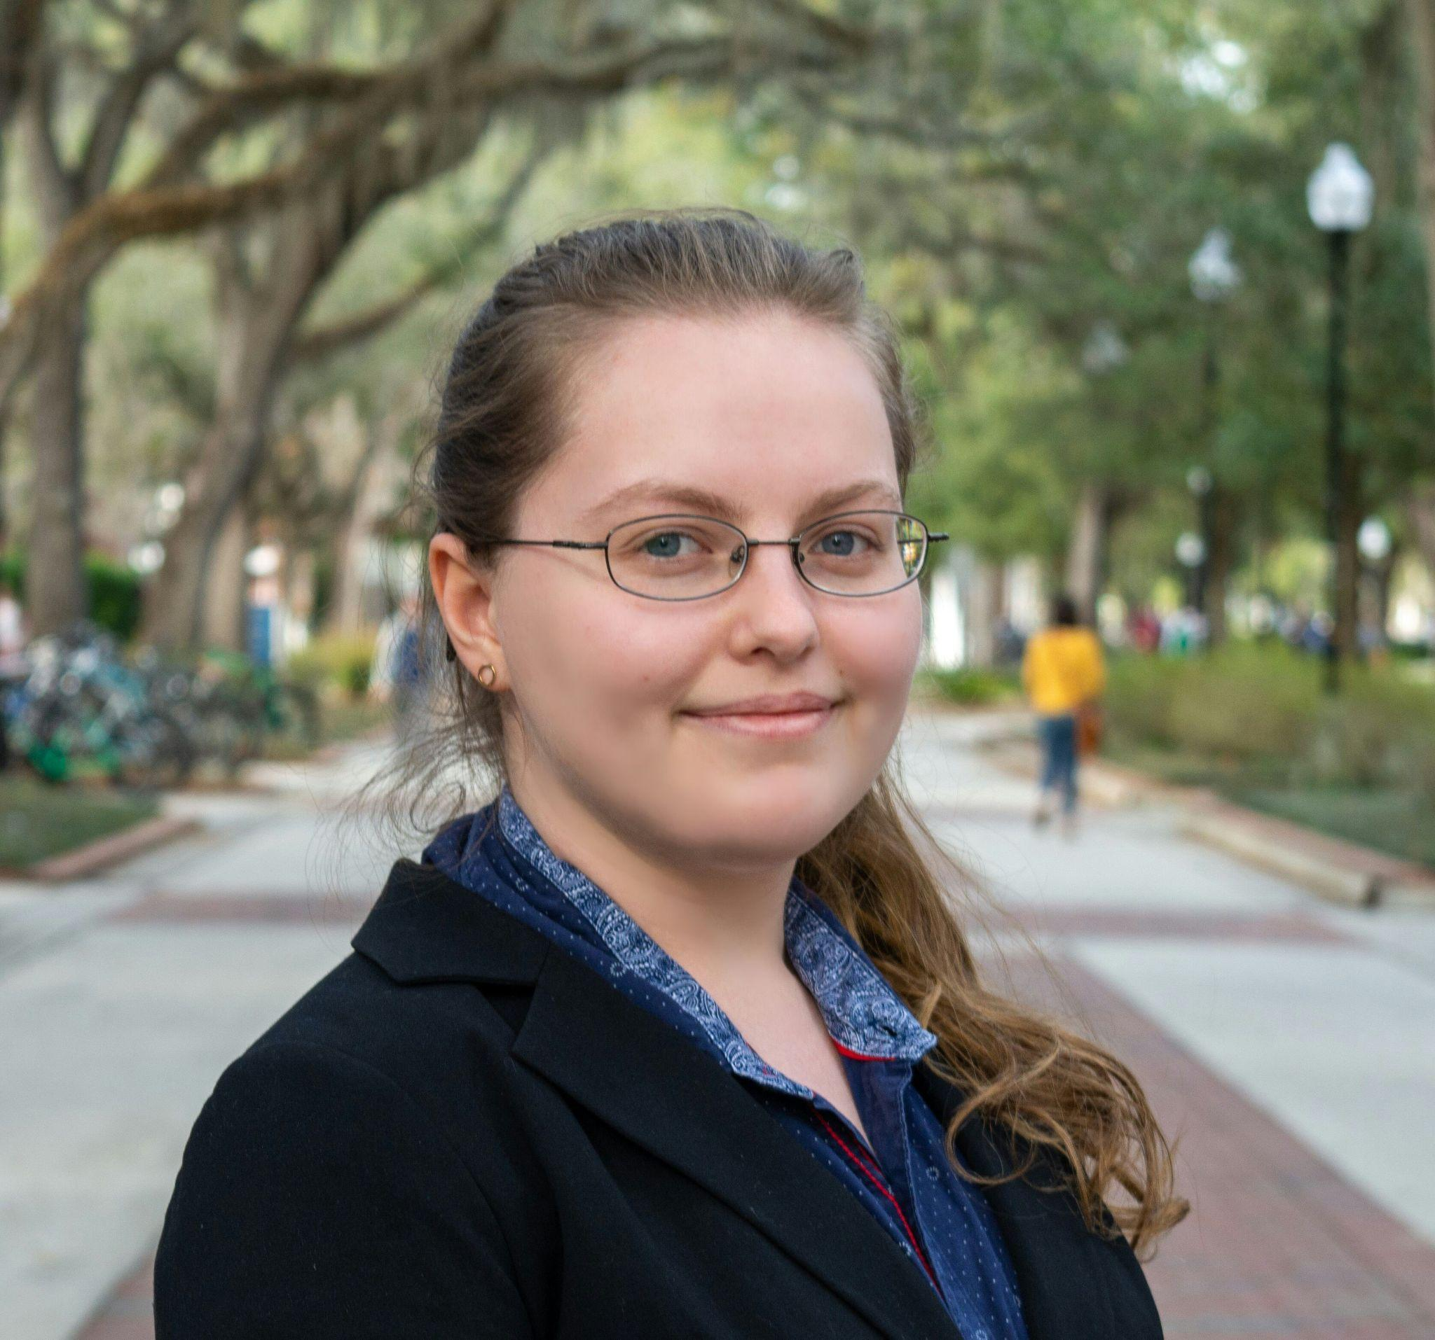

WHO WE ARE
COLE CRAWFORD
EWA WIERCIOCH
DR. KAZACHKOV
UF Industrial & Systems Engineering Senior
UF Industrial & Systems Engineering Senior
UF Industrial & Systems Engineering Assistant professor
Notes:
Math, programming -> better use of org resources, want to apply to non-profit

Slide 3
TABLE OF CONTENTS
01
02
03
04
PROJECT OBJECTIVE
CURRENT SYSTEM
PROGRESS
CURRENT PLAN

Slide 4
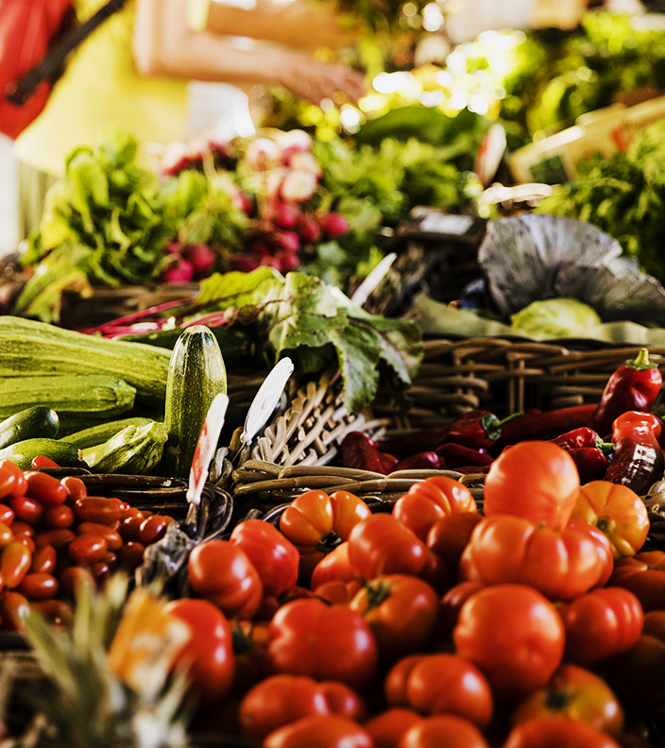
PROJECT OBJECTIVE
To extend the impact of current BOTM resources, such as time and money, to even better serve the community.
Understand current truck pickup routes
Suggest improvements

Slide 5
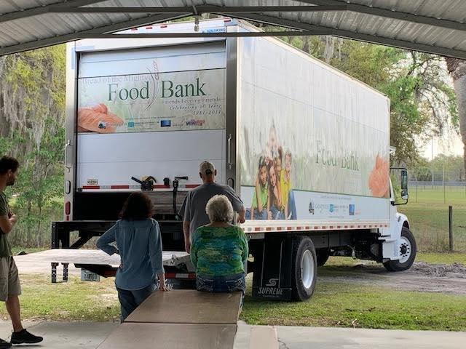
CURRENT SYSTEM
Based on our current understanding of what BOTM does:
50 retail pickup locations
65,000+ lbs of food/month
4 truck drivers
We’re excited to continue learning!
Notes:
“Here’s our understanding of current system, pls let us know if it’s right” # trucks, # dist/lb. per day, etc. Also how they currently route.

Slide 6
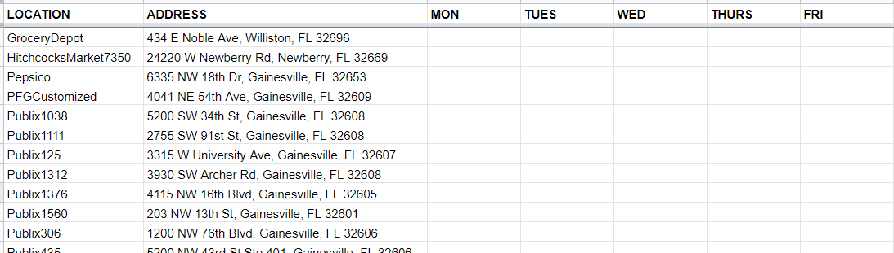
OUR PROGRESS
ADDRESSES
Database containing retail pickup information
Data to be filled in

Slide 7
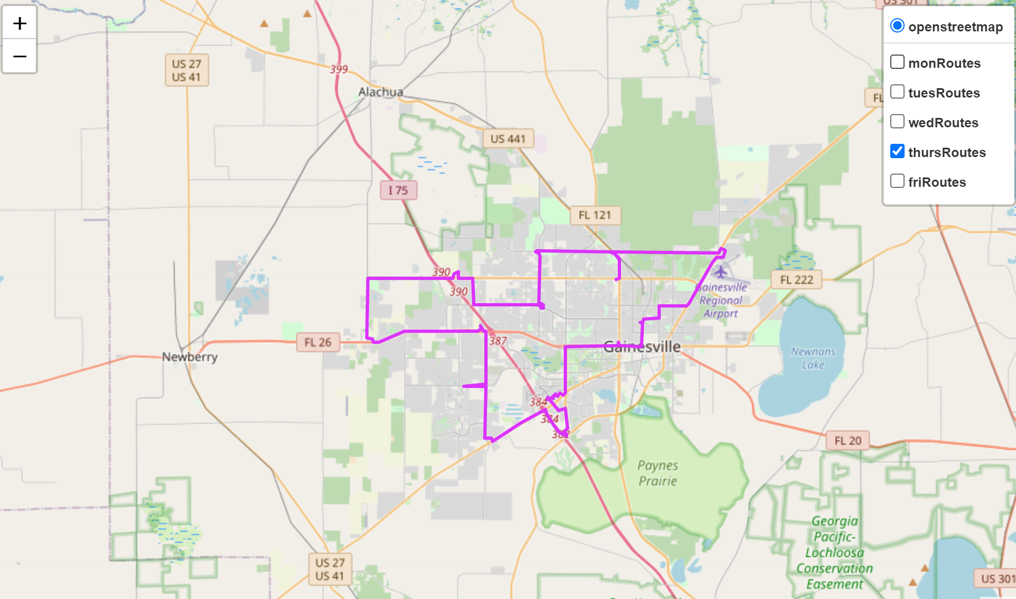
OUR PROGRESS
ROUTING OPTIMIZATION/VISUALIZATION
Distance Traveled: XX miles
Time Required: XX:XX hours

Slide 8
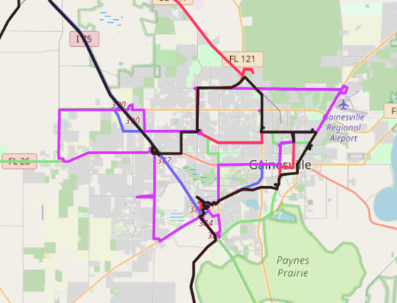
OUR PROGRESS
ROUTE VISUALIZATION
Color-coded routes

Slide 9
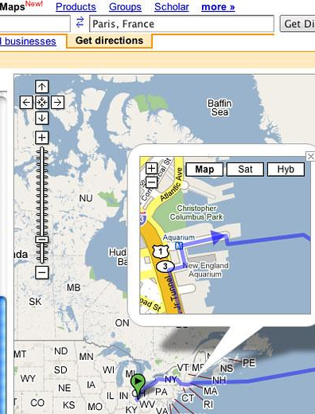
CURRENT PLAN
Incorporate time windows and truck capacity
Allow user to edit/add pickup locations and times (and edit BOTM location)
Notes:
Project interface?

Slide 10
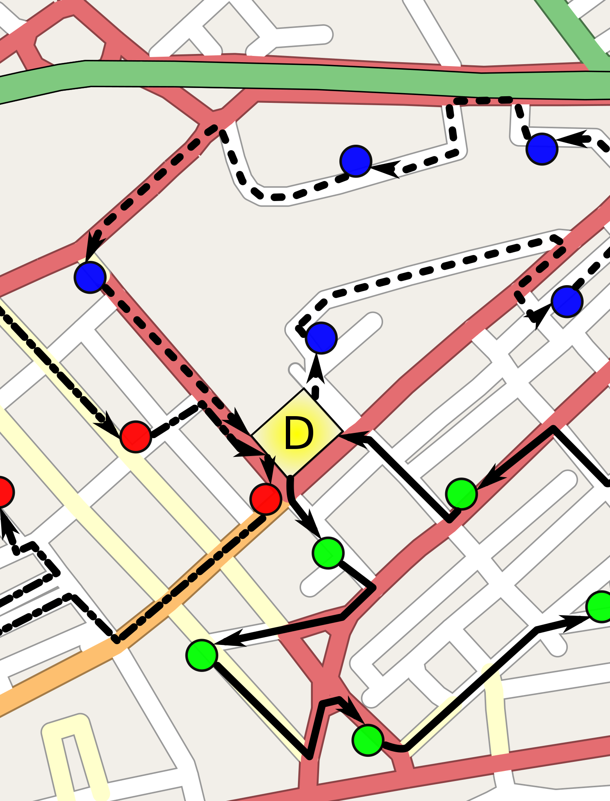
ADDITIONAL FEATURES
If time permits, based on BOTM feedback
Real-time routing in the case of last-minute pickups/cancellations
Suggest improvement opportunities to user
Calculate the amount of time and resources that can be saved
Notes:
Ask priorities
Additional Features/Possible Directions/”What are BOTM’s priorities?”
Limit text

Slide 11
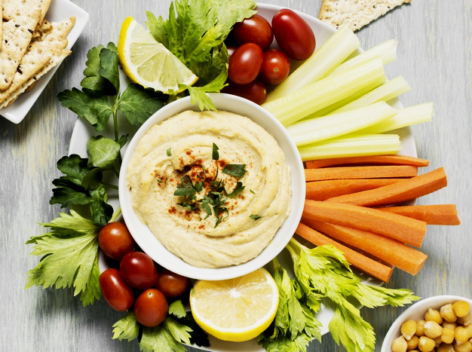
THANK YOU
We would love to hear your questions and feedback!
CREDITS: This presentation template was created by Slidesgo, including icons by Flaticon, and infographics & images by Freepik
Please keep this slide for attribution

